Slide 1
CCAD14 Project
Simple Multilevel Quest Game

Slide 2
Statement of Purpose
Purpose: The purpose of the game is to save the princess locked in a castle. Two valiant heroes are up for the adventure of recuing the princess from her precarious situation. The hero has two traverse different challenges to succeed in the quest. If the hero is able to overcome the challenges, he will be able to rescue the princess.

Slide 3
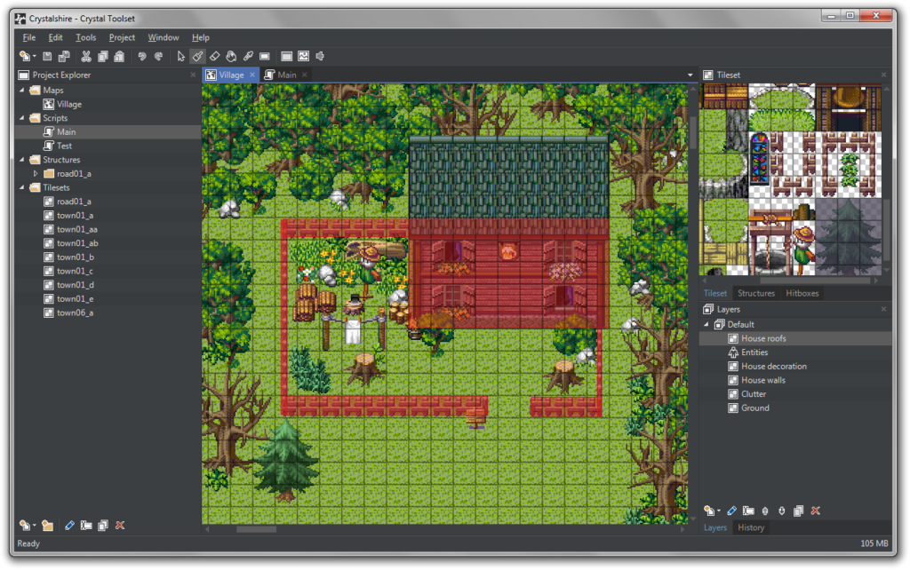
Runtime Environment
Desktop using WinForms

Slide 4
User Interface Outline and Functional Flow
Form 1: Start Screen: Explanation of Quest
Must click Enter or Button to begin
Form 2: Level 1 - Collect all coins to move on to next level. Task must be accomplished within a limited amount of time.
Form 3: Level 2 - Move through a maze to find key. After obtaining key take to door on other side of maze and enter to finish the game. Task must be accomplished within a limited amount of time.
Form 4(a): Level 3 - ?
Form 4: The End: Saved the Princess
Show message “Congrats, you have saved the princess.”
Show message “Want to play again?” Yes or No - Buttons

Slide 5
Classes, methods, and properties (work in progress)
Core Class:
Type keys to assign key press (up, down, left, right).
Type booleans to determine if key was pressed.
Player Class:
(Use timer tool to move objects.)
Speed property
Update method
Object Class:
Methods: Coins, key, door, etc.

